Slide 1

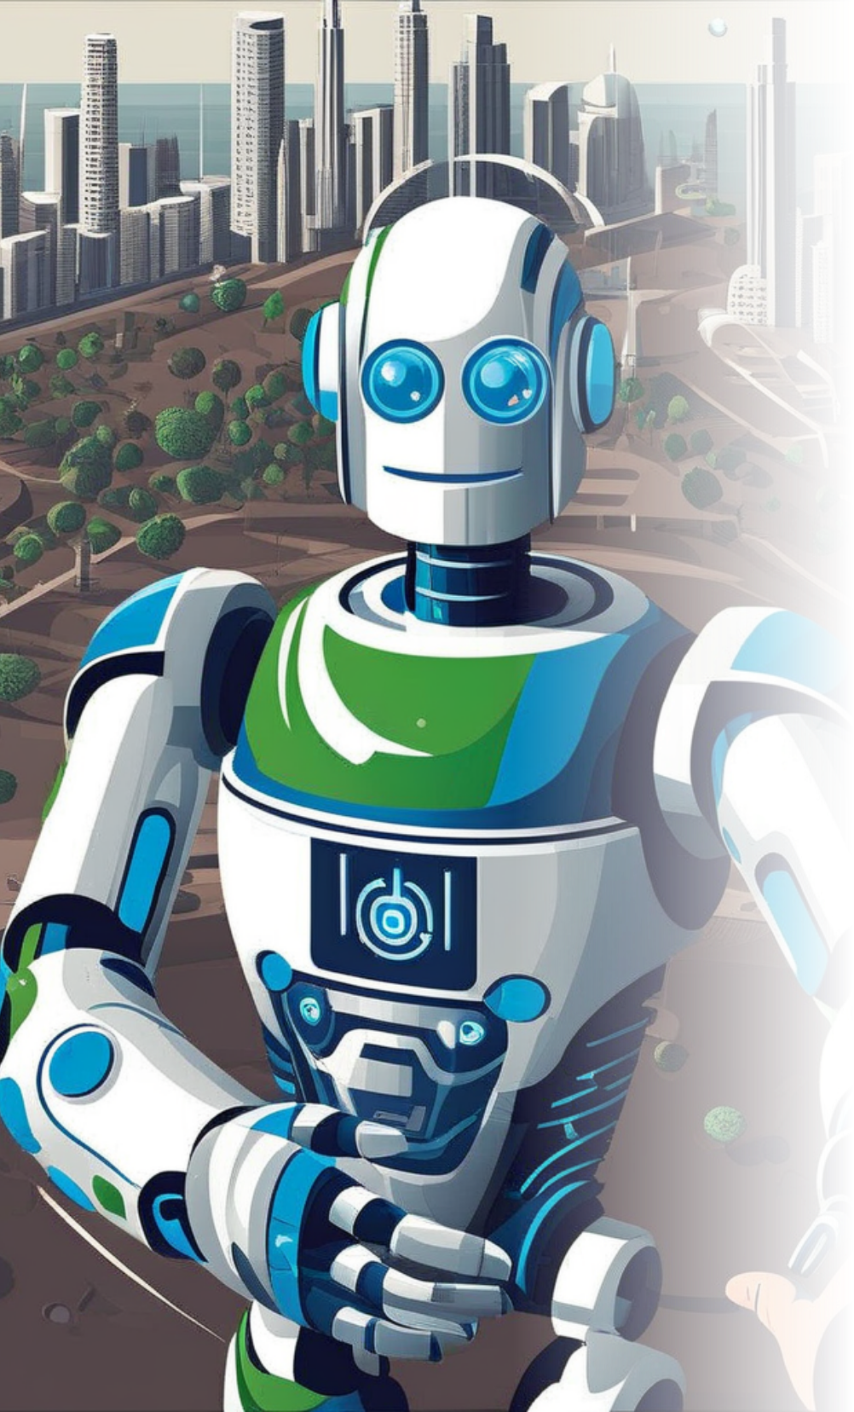
AI Agents for Disaster Response
This presentation outlines the application of AI agents in disaster response planning, examining their capabilities, benefits, challenges, and future potential in enhancing emergency management efficiency.

Slide 2


Overview of AI in Disaster Response
Definition of AI Agents
AI agents are autonomous systems capable of analyzing data, making decisions, and performing tasks without human intervention, specifically tailored for disaster management tasks.
Importance of Disaster Response
Efficient disaster response minimizes casualties and damages, making timely and informed decision-making critical to saving lives during emergencies.
Role of AI
AI can process vast datasets quickly, predict disaster impacts, and assist in resource allocation, offering a significant advantage over traditional methods.

Slide 3



Benefits of AI Agents
1
Enhanced Decision-Making
2
Resource Optimization
AI algorithms can analyze data from multiple sources, leading to more accurate predictions of disaster outcomes and enabling better strategic planning.
AI helps in intelligent distribution of resources by analyzing current needs and optimizing logistics, ensuring the right resources reach the most affected areas promptly.
3
Real-Time Situational Awareness
4
Scalability and Adaptability
AI systems continuously monitor situational changes, providing up-to-date information that can assist responders in adapting their strategies to evolving conditions.
AI agents can scale operations quickly during crisis situations and adapt to different types of disasters, making them versatile tools for emergency management.

Slide 4





Challenges in Implementation
Data Privacy Concerns
Reliability of AI Models
The collection and use of data, especially personal data, raise ethical concerns regarding privacy and consent in AI deployment during disasters.
AI systems rely on accurate data; faulty models or data biases can lead to incorrect predictions, potentially worsening disaster response efforts.
1
2
Integration with Existing Systems
Resource Constraints
4
3
Implementation of AI solutions may require significant financial investment and technical resources, which can be restrictive for many organizations.
Integrating AI technology with current emergency management systems poses technical challenges, requiring training and adjustment from human operators.

Slide 5
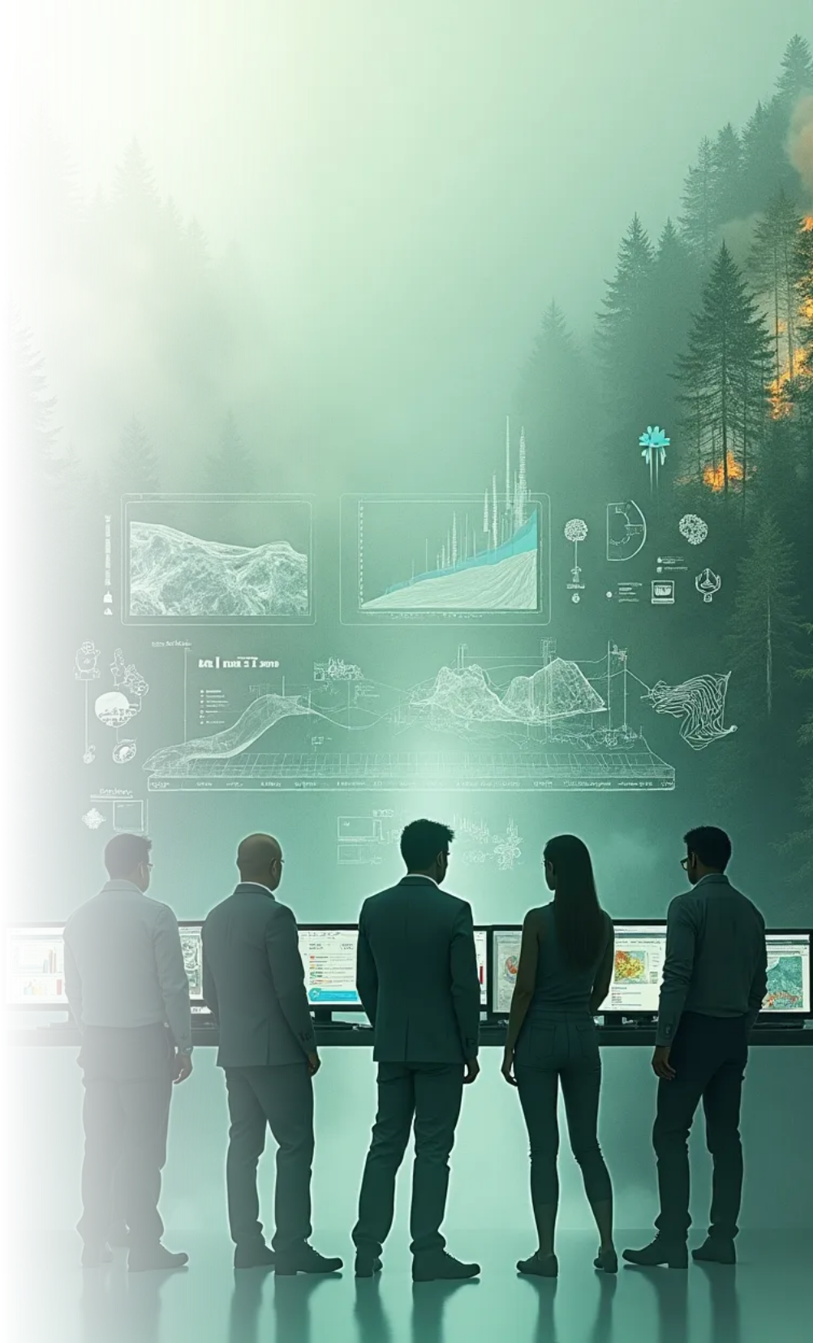

Case Studies of AI Use
AI in Earthquake Response
Flood Prediction Models
Review of AI models used for real-time seismic data analysis.
Examination of AI systems predicting flooding through data analysis.
Wildfire Management
Collaboration with Local Authorities
Discussion on forecasting wildfire patterns using AI.
Examples of AI in local emergency management frameworks.

Slide 6




Future of AI in Disaster Response
Advancements in Machine Learning
Greater Collaboration
Enhancing synergy between AI systems and human experts in disaster management.
Improving predictive models for better accuracy in disaster scenarios.
1
2
Public Awareness and Training
Policy Development
4
3
Driving regulatory frameworks for effective AI use in disaster response.
Preparing responders through training programs to effectively use AI technology.

Slide 7





Conclusion
Integration is Essential
Empowering Responders
The integration of AI agents into disaster response frameworks shows immense potential but requires addressing challenges related to ethics, data accuracy, and human-AI collaboration.
AI should be viewed as a tool to empower human responders rather than replace them, enhancing their decision-making capabilities and improving overall disaster management strategies.
Commitment to Innovation
Global Collaboration for Success
Continued investment in AI research and development is crucial, ensuring that future innovations in this field can meet the ever-evolving challenges posed by disasters.
Successful implementation will depend on international cooperation, knowledge sharing, and best practices in leveraging AI for disaster response globally.

